Slide 1
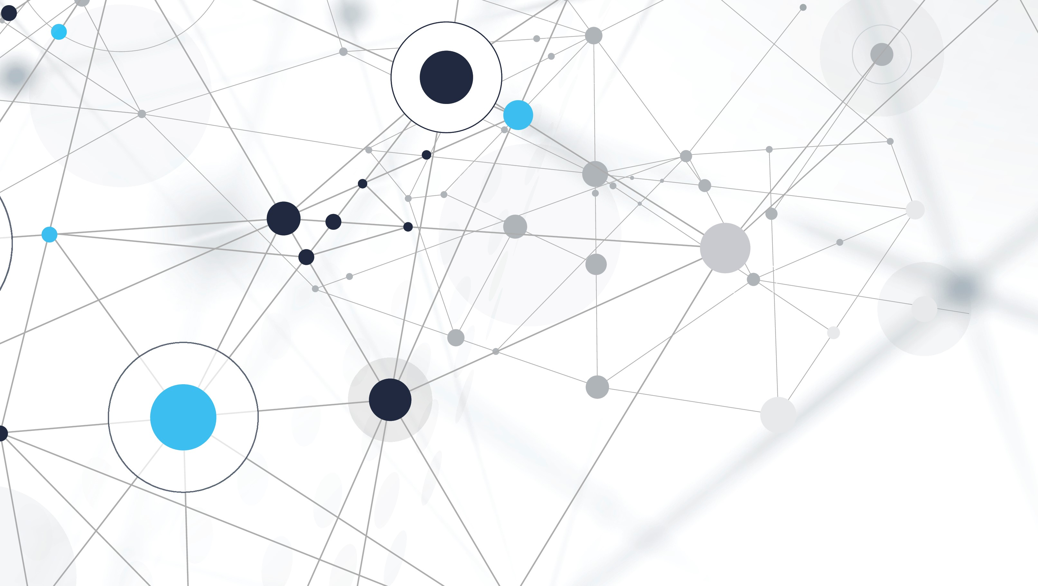
Speech recognition system (using python)
Presented by-
Anupriya Lathey 102103373 Hargun Singh Walia 102103386
Nitleen Kaur 102103377 Radhika Jasra 102103815

Slide 2
Why python?
Speech recognition is the process of converting spoken language into text.
In AI, speech recognition is achieved through machine learning algorithms that can learn from examples of spoken language to recognize and transcribe speech accurately.
Python is a popular programming language for implementing speech recognition systems because of its simplicity, versatility, and rich ecosystem of libraries.

Slide 3
Principle of speech recognition
Data Collection: The first step is to collect audio data that will be used to train the speech recognition model. The audio data can be in the form of audio recordings or live audio input.
Feature Extraction: Once the audio data has been collected, the next step is to extract relevant features from it.
Model Training: After the features have been extracted, they are used to train a machine learning model.
Speech Recognition: Once the model has been trained, it can be used to recognize speech in new audio input.
Error Correction: The final step is to correct any errors in the text transcription.

Slide 4
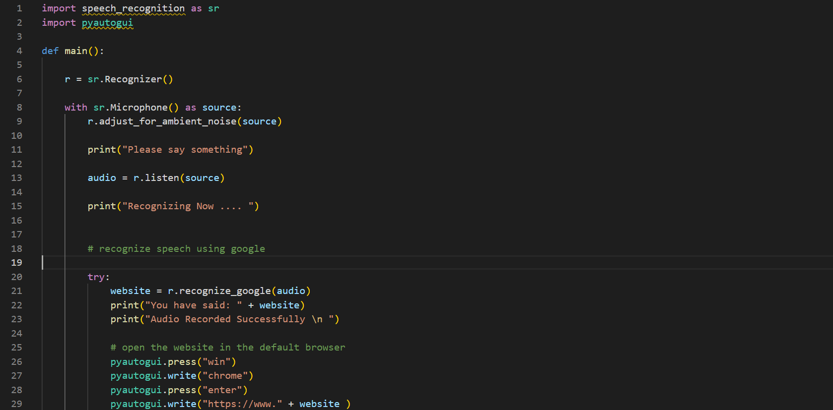
Code

Slide 5
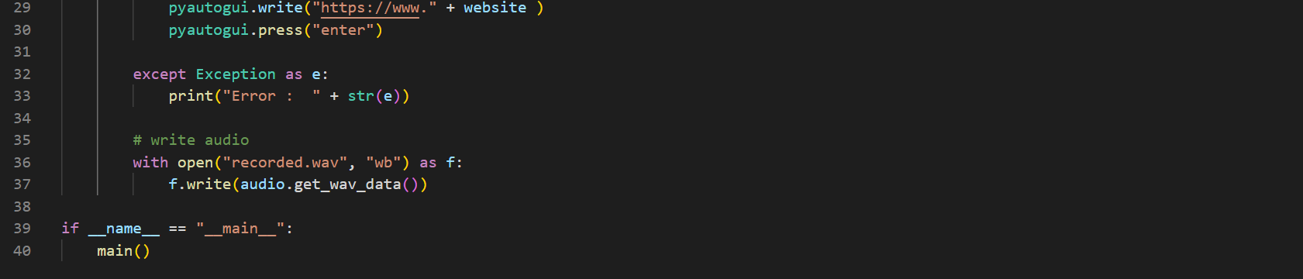
Contd.
This is a Python program that uses the ‘speech_recognition’ library to recognize speech input from the user and open a website in the default browser based on the recognized input. The ‘pyautogui’ library is used to simulate keyboard input to open the browser and enter the website address.

Slide 6
Working of the program
The program first imports the required libraries: speech_recognition and pyautogui.
The main() function initializes a speech recognizer object (r) and sets up the microphone as the audio source. It then adjusts for ambient noise to improve the accuracy of the speech recognition.
The user is prompted to say something, and the program records the audio input using the microphone.
The recognize_google() method of the speech recognizer object is used to convert the recorded audio input into text, which is stored in the website variable.
The program attempts to open the website in the default browser using pyautogui. It first presses the Windows key, then types "chrome" to open the browser, and finally types the website address to navigate to the website.If an error occurs during the speech recognition process, an error message is printed to the console.
The recorded audio data is then saved to a WAV file named "recorded.wav".Finally, the main() function is called if the program is run as the main module.

Slide 7
Applications
Virtual assistants: Voice recognition technology is used to develop virtual assistants like Siri, Alexa, Google Assistant, and others.
Dictation software: Voice recognition technology is used to develop dictation software that converts spoken words into text. This is particularly useful for individuals with disabilities or those who find typing difficult.
Customer service: Voice recognition technology is used in call centers to automate customer service interactions.
Language translation: Voice recognition technology is used in language translation applications to convert spoken words from one language into another. This is particularly useful for individuals traveling to foreign countries or for businesses operating in global markets.
Automotive industry: Voice recognition technology is used in the automotive industry to develop systems that allow drivers to control various functions of their vehicle using their voice. This includes controlling the radio, air conditioning, and navigation systems.

Slide 8
conclusion
In conclusion, voice recognition is a critical application of AI that enables machines to understand and interpret human speech.
It has numerous practical applications in various industries, including virtual assistants, dictation software, customer service, language translation, and the automotive industry.
As AI technology continues to improve, we can expect voice recognition to become even more advanced, accurate, and versatile, enabling machines to interact with humans in increasingly natural and intuitive ways.

